Slide 1
Biological Sciences B. CHEM. ENGG. Part 2. Cell Division Dr. Ratnesh Jain

Slide 2
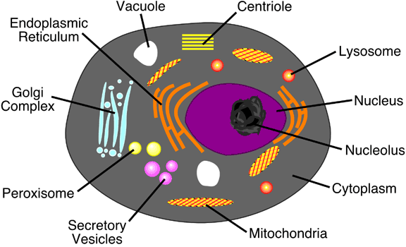
Animal Cell Culture
Technique used for growing animal cells in-vitro to produce large amounts of biologically important compounds in a short period of time
To understand basic functions of cells like growth, metabolism, and reproduction

Slide 3
Nucleus: surrounded by nuclear membrane; nucleoli containing DNA, RNA and proteins; and chromatin:DNA and some proteins; store genetic information, promote cell division, promote protein synthesis
Mitochondria: double membrane, internal folds called cristae; energy is produced by the respiration process and the ATP cycle
Lysosomes: dispose cell metabolites, pathogenic bacteria, and dead cell organelles with degrading enzymes
Golgi Complex/Apparatus: several layers of flattened membranes; manufacture, store, transport proteins essential for cellular survival
Ribosomes: free or bound to the endoplasmic reticulum; mRNA translation, protein synthesis
Endoplasmic Reticulum: interconnected tubes, vesicles, and sacs, rough: ribosomes: protein synthesis; smooth: protein transportation
Centrioles: tube-like structures made of microtubules near nucleus, form mitotic spindle/spindle fibers which help in distribution of chromosomes from the mother cell to the daughter cell during cell division

Slide 4
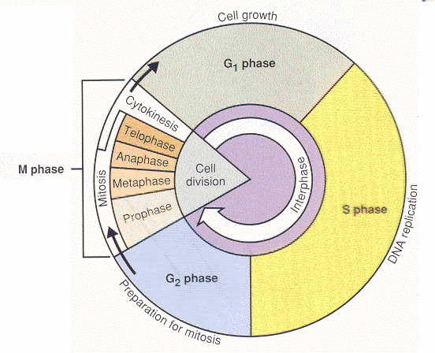
Controlled by specialized proteins (regulatory proteins); prevents abnorrmal cell growth
G0 (Gap 0) Phase: resting state after undergoing cell division and are temporarily out of the cell cycle
G1 (Gap 1) Phase: number of cells increases significantly due to rapid cell division , protein synthesis
S (Synthesis) Phase: DNA replication and copying of chromosomes, important prerequisite for cell division
G2 (Gap 2) Phase: between S-phase and the M-phase; Amount of cytoplasm (including organelles) increases in preparation for division
M (Mitosis) Phase: protein synthesis and cell growth are stopped, involves 5 stages
Cell cycle

Slide 5
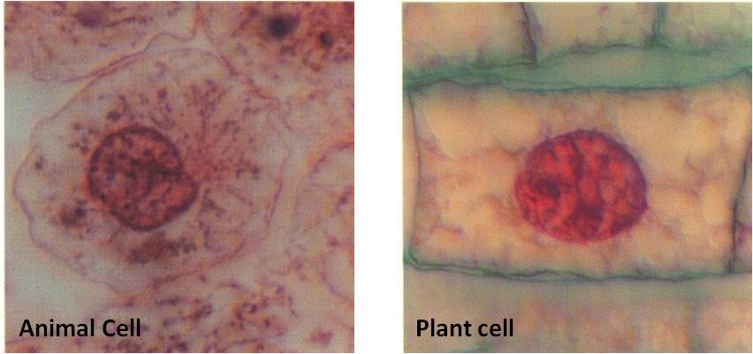
Cell division
Asexual reproductive process of cells employed for producing identical daughter cells
Mitosis or meiosis
Mitosis
Interphase: Longest phase in the cell cycle; DNA/Chromosomes replication; protein synthesis and centriole division in preparation of upcoming division

Slide 6
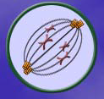
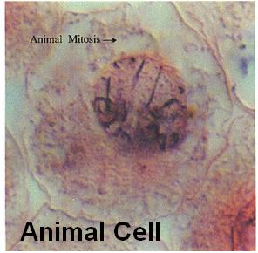
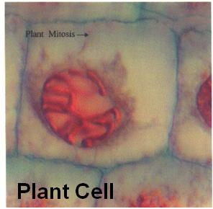
Prophase
Chromosomes: Shorten and become visible; condensation of chromatin
Centrioles move to opposite sides of the cell;
Nuclear membrane disappears
Spindle Fibres & Astral Fibres both together are known as the Spindle Apparatus begin to form

Slide 7
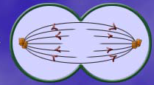
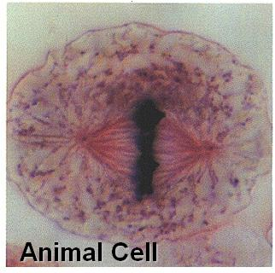
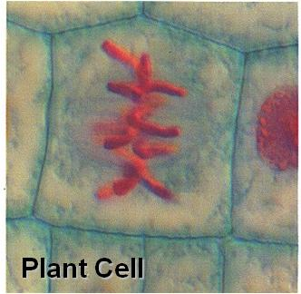
Metaphase
Chromosomes line up along center of cell called the Metaphase Plate, equidistant from centrioles
Chromosomes attach to spindle fibers
Spindle & Astral fibres are now clearly visible

Slide 8
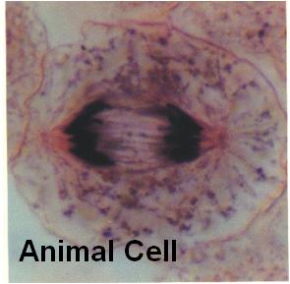
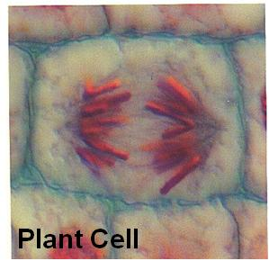
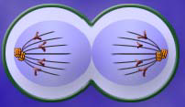
Anaphase
Centromeres break up separating chromosome copies (daughter chromosomes)
Daughter chromosomes are pulled apart to opposite sides of cell
Spindle & Astral fibres begin to break down

Slide 9
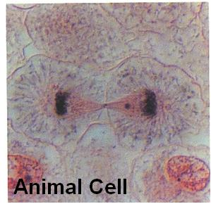
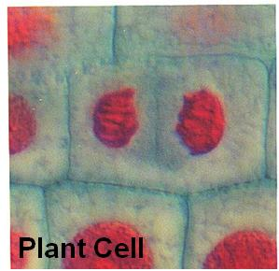
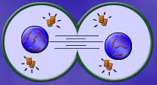
Telophase
Nuclear envelope forms around both sets of chromosomes
DNA uncoils
Spindle & Astral fibers completely disappear
Cytokinesis happens with most (but not all) cells
Cytoplasm & organelles move (mostly equally) to either side of the cell. Cell Membrane “pinches” to form 2 separate cells

Slide 10
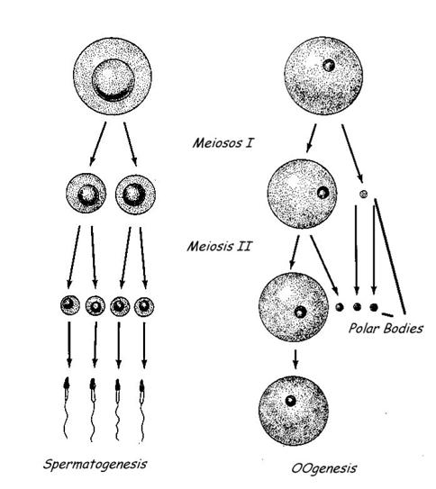
Meiosis
Similar in many ways to mitosis
Involves 2 cell divisions
Results in 4 cells with 1/2 the normal genetic information
Meiosis results in the formation of haploid cells
Ova (egg) and sperm
Oogenesis (ovaries of females)
Spermatogenesis (testes of males)
Occurs in 2 phases

Slide 11
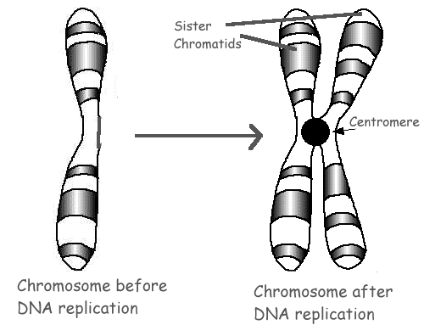
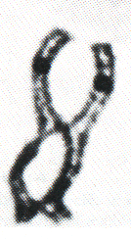
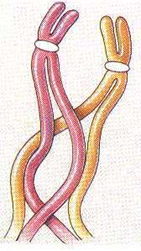
Meiosis I, & Meiosis II
Meiosis I
Prior to division, amount of DNA doubles
During metaphase 1 homologous chromosomes line-up along the metaphase plate
Areas of homologous chromosomes connect at areas called chiasmata

Slide 12
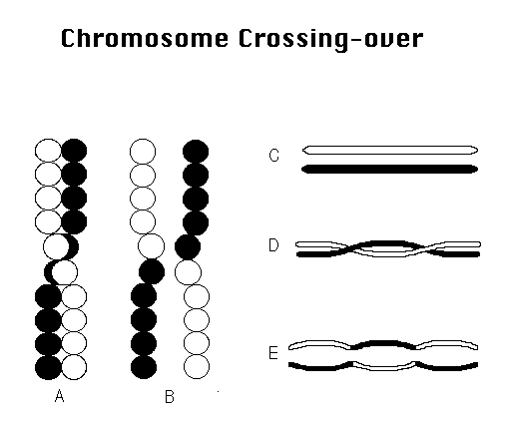
Crossing Over of genes occurs now
Segments of homologous chromosomes break and reform at similar locations
Results in new genetic combinations of offspring
This is the main advantage of sexual reproduction

Slide 13
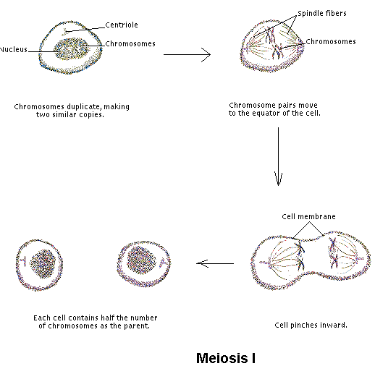
During anaphase 1, each homologous chromosome is pulled to opposite sides of the cell
Unlike mitosis, THE CENTROMERES DO NOT BREAK
Nuclei may or may not reform following division
Cytokenesis may or may not occur

Slide 14
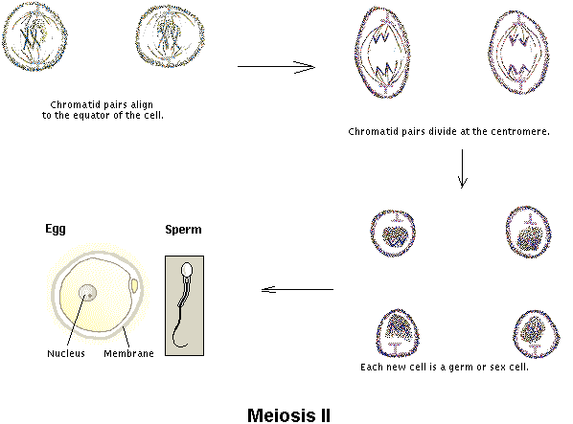
Meiosis II
DNA does not double
Chromosomes randomly line-up along metaphase plate as regular mitosis
During anaphase 2, CENTROMERES BREAK and each chromosome is pulled to opposite sides of the cell
Nuclei reform and cytokenesis usually occurs (although often unequal)

Slide 15
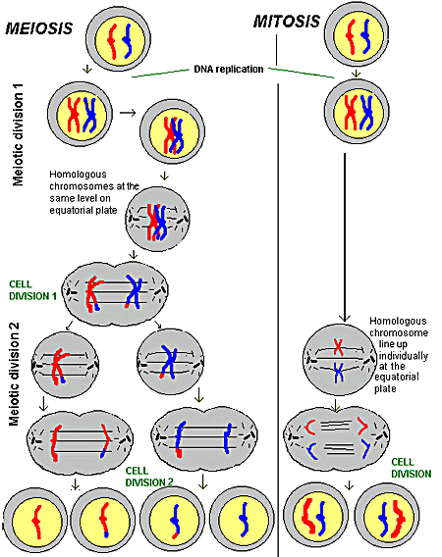

Slide 16
Wish you acedemic success!

